Slide 1
Automation of Basis RBP & RWP systems Hourly Monitoring

Slide 2

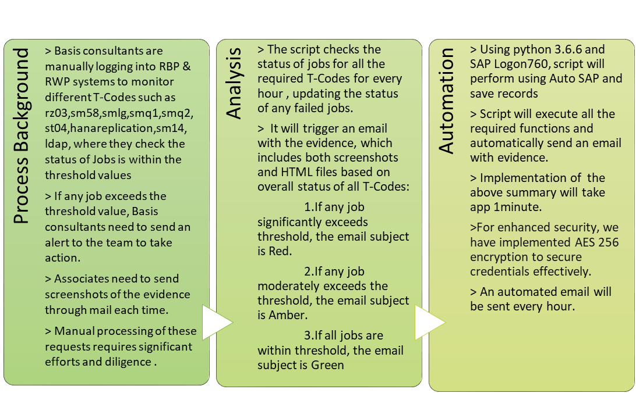
RBP & RWP Hourly Monitoring
Business Value
94%
  Reduction in execution time
100%
  Data Accuracy
Zero
  Manual intervention
Evidence
  Better Documentation
168 Hours
  Efforts saved per month

Slide 3
RBP & RWP Monitoring Automation Workflow Chart:
Login to SAP systems RBP & RWP
Enter required T-Codes
Repeat for each T-Code
Check If any value exceeds threshold
Send alert email with evidence & subject line indicating RED if any status is red otherwise indicates Amber
Extract the data and store the evidence
yes
no
Send successful mail with evidences & subject line indicating Green
Logout to SAP

Slide 4
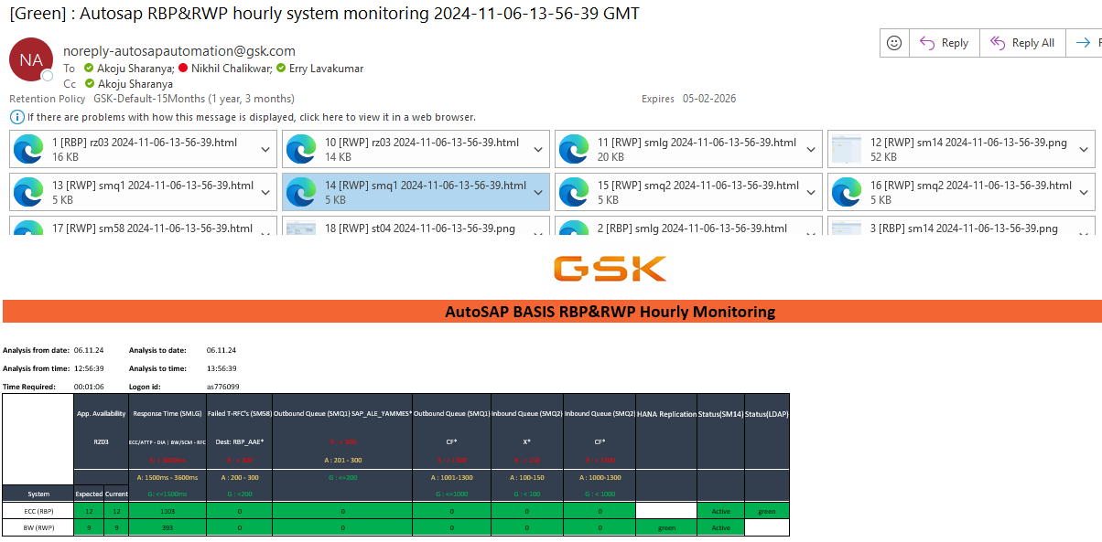
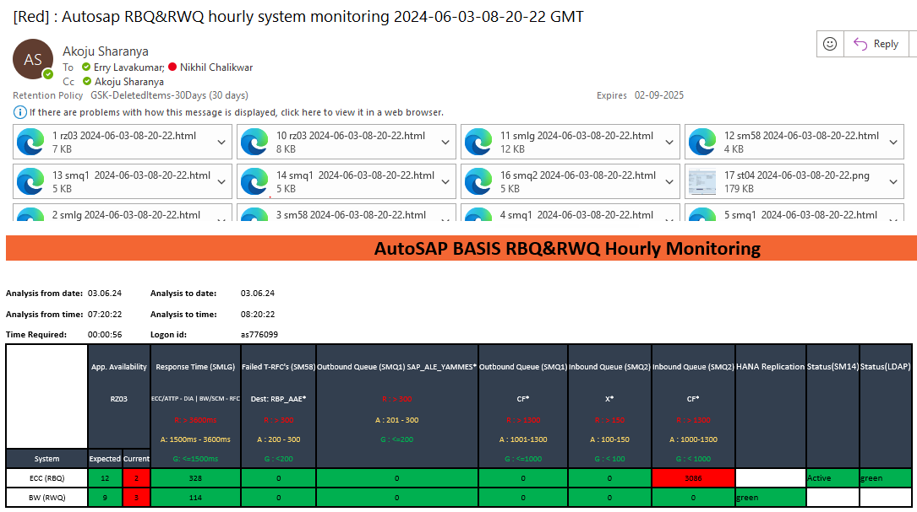
Mail Template

Slide 5
Q&A

Slide 6
Thank You

